Slide 1

StraySpotter
[source code website]
[project website]
Asa Dillahunty, Dylan Marcum-Pollard,
Lillian Presley, Sav Campbell

Slide 2
Project Overview
The focus of our project was to create an application that allowed the user to both upload pictures of stray animals that they find during their everyday lives and browse the pictures for sightings of their missing pets.
To do this, uploaded pictures needed to have their locations stored and we needed a way for those pictures to be found by the user. The idea was that if you knew where your animal was spotted, it could assist in finding your lost pet.
Notes:
Sav

Slide 3
Sprint Overview
Our goals for Sprint 3 included:
Secure Firebase rules - Dylan
Finish the image picking and merge - Lilly
Finish the user profiles and implement Firebase Auth - Asa
Flagging posts for strays found & inappropriate content - Sav
Create image descriptions - Sav
Sorting the database by time uploaded - Dylan
Final clean up and comments - Everyone
Notes:
Dylan

Slide 4
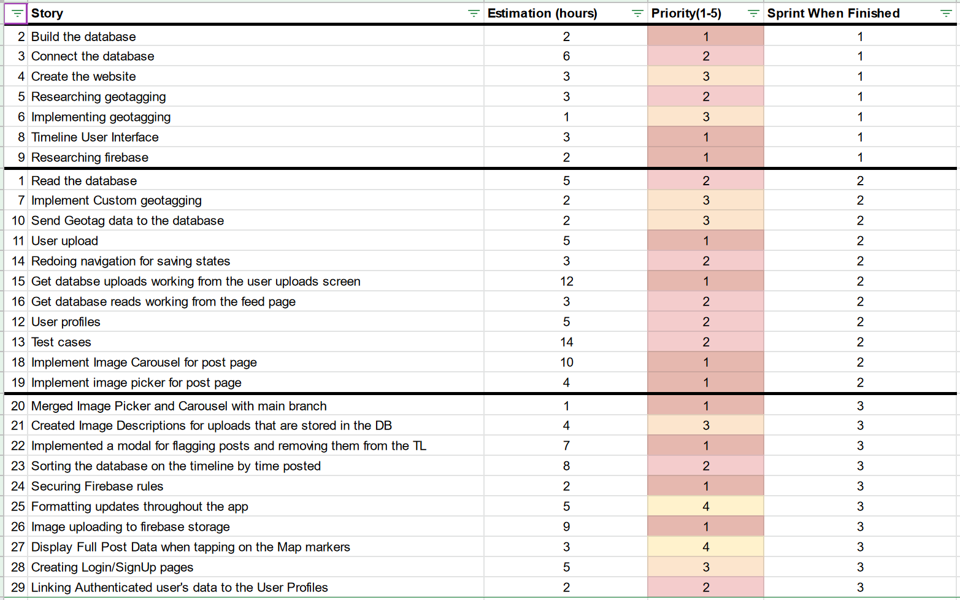
Sprint Backlog
Notes:
Asa

Slide 5
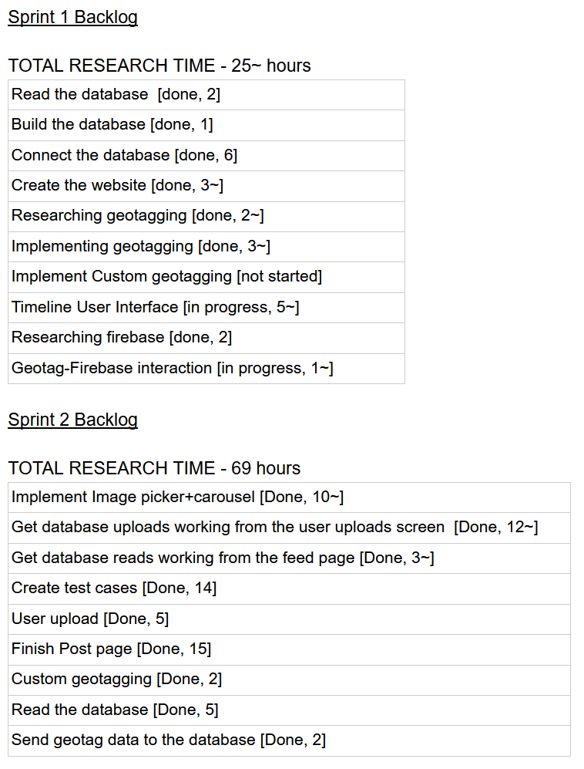
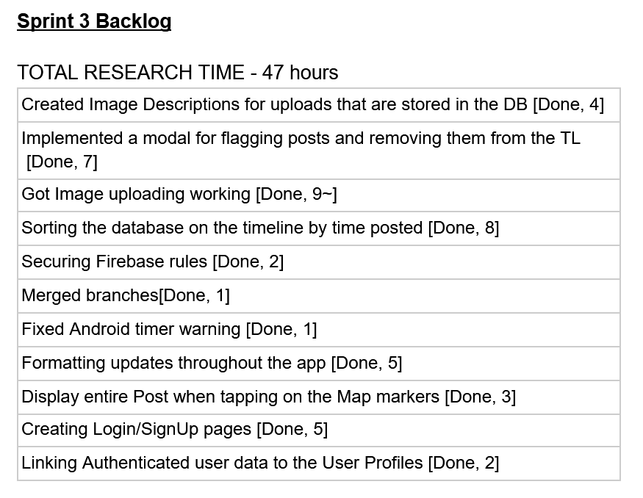
Sprint Backlog

Slide 6
Sprint Reflection
We successfully completed all of the core features in the app!! (user logins, uploading, viewing posts)
Setting aside time to work on the project together helped hold us accountable during this sprint.
Sometimes we under or over estimated how long things would take to complete
Sorting the database took longer to implement
Post flagging did not take too long to implement
Notes:
Lily- list this off

Slide 7
Final Project Reflections
Overall, we’re happy with the final product!
Some challenges we ran into over the course of the project:
Getting React and Expo code to work nicely together
Restructuring code sometimes broke components that were in progress
Some things that went well over the course of the project:
We worked well together and fell into team roles easily
We were able to help each other out when we started working on features that others may know more about

Slide 8
Demo Description
We will walk through the general UI of the app and then will show the frontend and backend of the app through a stray upload
Link to Firebase
Notes:
Link: https://console.firebase.google.com/u/2/project/stray-spotter/firestore/data/~2FStraysFound~2FGgRKktdJjojqZyFpMHmH

